Slide 1
Generative AI - Opportunities or Threats for Higher Education
GANGMIN LI
School of Computer Science & Technology
Faculty of Creative Arts, Technologies and Science
EMAIL: GANGMIN.LI@BEDS.AC.UK
Web: https://gangminli.github.io

Slide 2
Outline
What is Generative AI
What can it do?
Is it opportunity or threat for HE?
What will we do?

Slide 3

Questions?
Who has used:
GPT
GPT3
GPT4
ChatGPT
midjourney
Stable diffusion
llElevenLabs
LOVO AI
Genny
Play.ht

Slide 4
They are all GAI models

Slide 5
1. What is GAI?

Slide 6

An Example: Open Day Video

Slide 7
Questions
How long does it take to produce?
How many people participant?
How much does it cost?

Slide 8
Answers
A single person, 5 days, no extra cost.
It was me and
I Spent a whole week (leaning and trying)

Slide 9
Here are the AI models used
https://gangminli.github.io/
Use ChatGPT create movie script
Use “midjurney” create Avatar
Use “Play.ht”. Create my audio (text 2 voice)
Use “D-id.com” Animate my Avatar
Editing and Finalize my Video using “Descript”.

Slide 10
What is Generative AI?
Generative artificial intelligence, often referred to as Generative AI, is a subfield of artificial intelligence (AI) focused on creating models that can generate new data (such as text, images, audio, or other forms of media) based on patterns and structures learned from existing data.
This technology leverages generative models, which are trained on large datasets to understand and replicate the characteristics and distribution of the input data.

Slide 11
What is Generative AI?
Generative AI can generate human-like content based on massive training datasets (deep learning) and neural networks (deep networks) technology

Slide 12
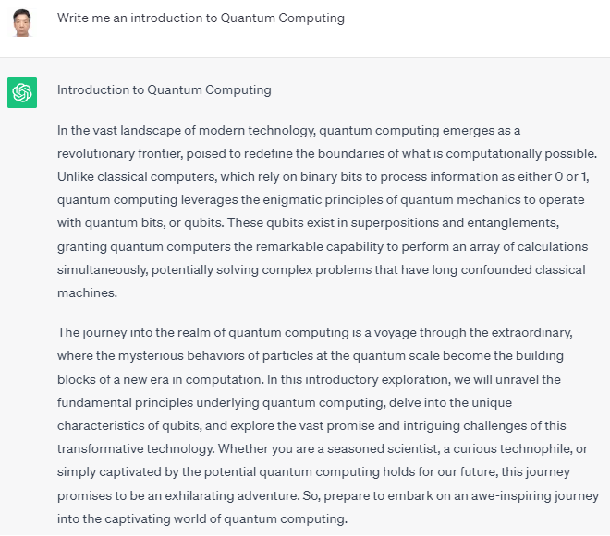
Generative AI Models
Text Generation: Generative AI models like GPT (Generative Pre-trained Transformer) can produce coherent and contextually relevant text, which has applications in natural language processing, content creation, and chatbots
Write me an introduction to Quantum Computing
Prompt

Slide 13
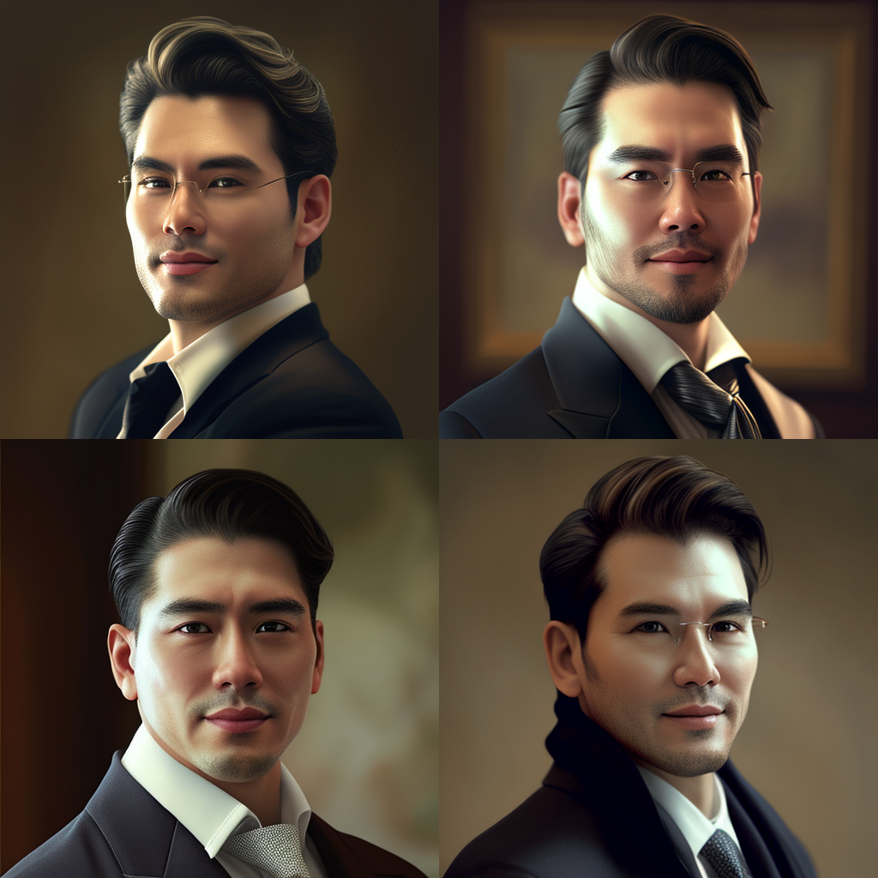
Generative AI Models
Image Generation: Dall-E can generate images from textual descriptions, enabling creative and novel content creation in the visual arts.
A young handsome Asia University lecturer
Prompt

Slide 14

Generative AI Models
Voice and Audio Generation: Generative AI can create realistic speech and audio, which is useful in voice assistants, audiobook production, and more.
Information is a critical resource that vital role in shaping our …
Prompt

Slide 15
2. What can GAI do?

Slide 16
What can GAI do?
Perform a wide range of intellectual tasks, akin to human capabilities, but typically with fewer errors. It's a powerful technology that can be used for tasks like content generation, creative writing, image creation, and more.
GAI's capabilities are still evolving, and its full potential is being explored in various domains, including creative arts, research, and automation of content production.
GAI is a significant advancement in the field of artificial intelligence with promising applications in multiple industries.

Slide 17

This is Just the tip of the iceberg.
There are more GAI models, more professional and aims at more specific application domain, comes every day!

Slide 18
In HE domain
There are GAI tools for
Students
Academics

Slide 19
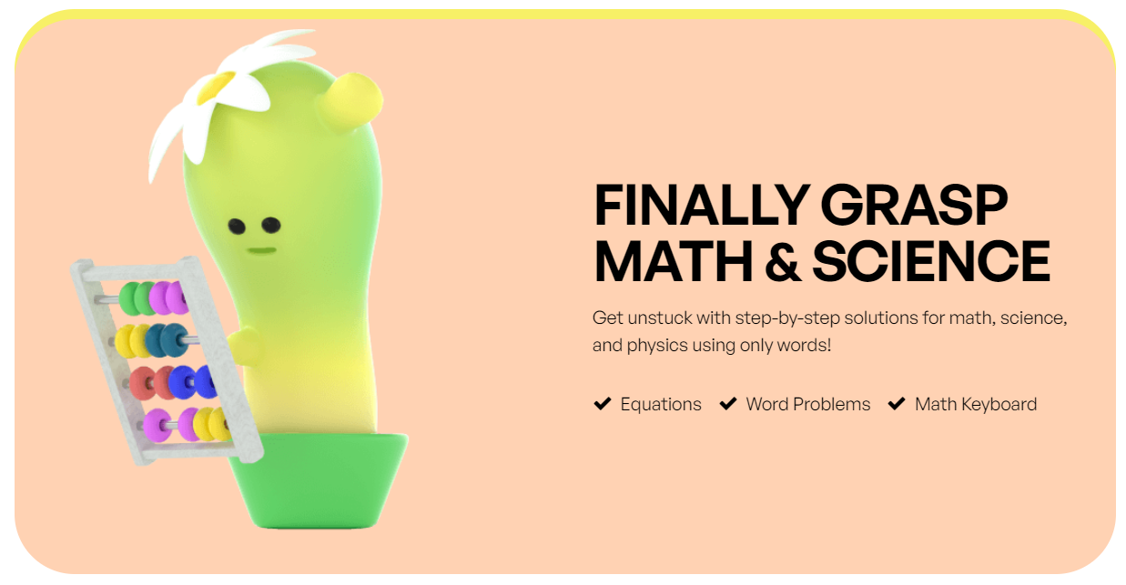

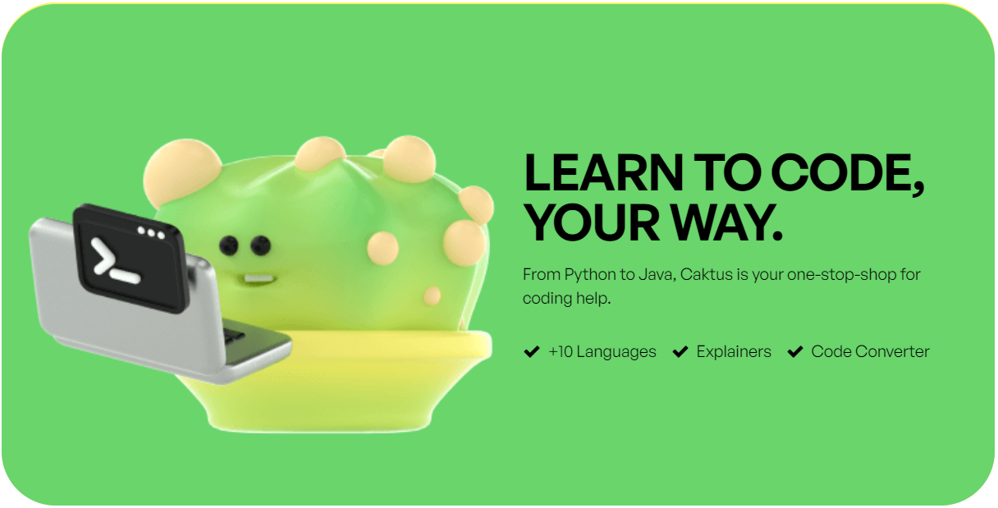

GAI tools for Students
Caktus

Slide 20
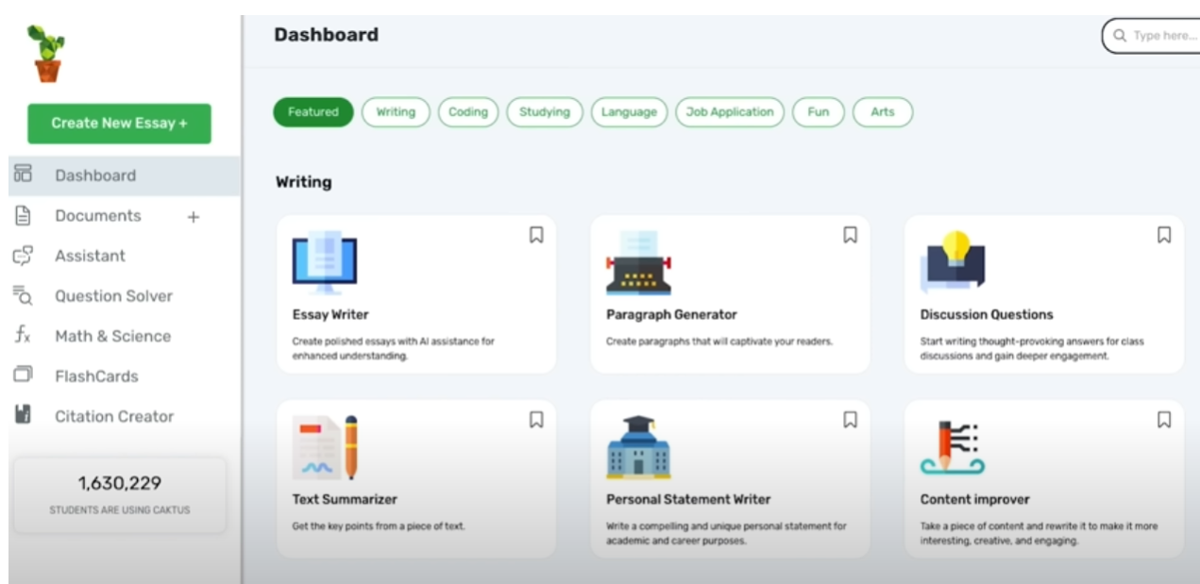
GAI tools for Students Caktus (5$/m)

Slide 21
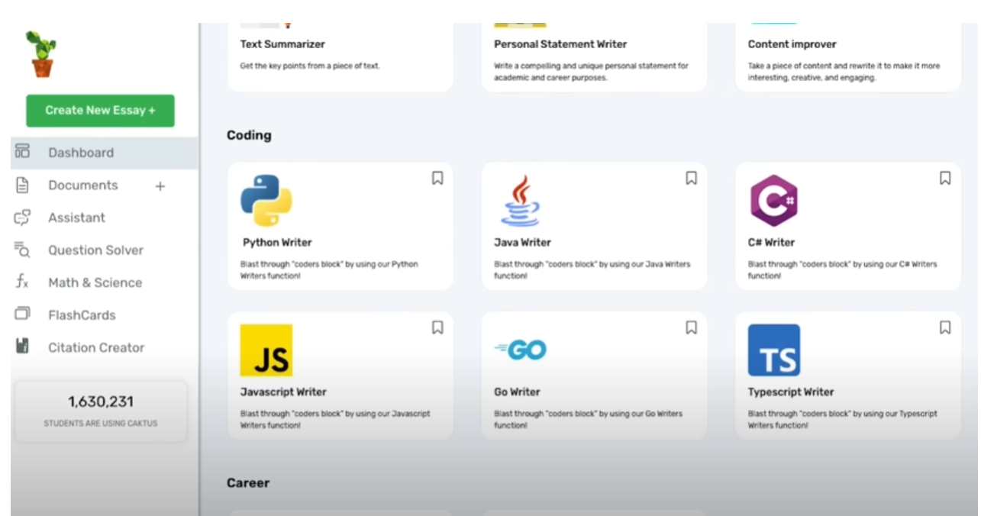
GAI tools for Students Caktus (5$/m)

Slide 22
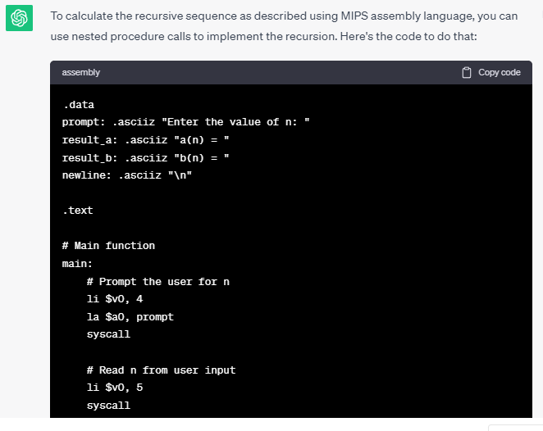
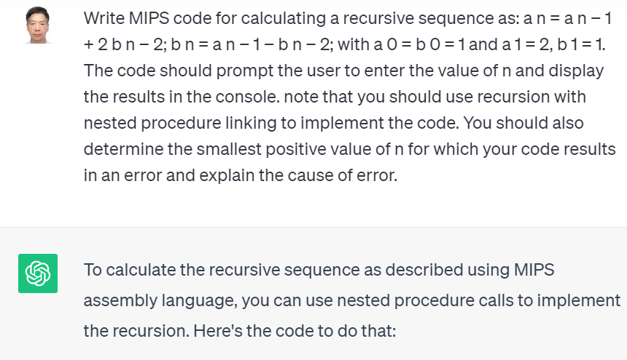
ChatGPT
8. Write MIPS code for calculating a recursive sequence as: a n = a n − 1 + 2 b n − 2; b n = a n − 1 − b n − 2; with a 0 = b 0 = 1 and a 1 = 2, b 1 = 1. The code should prompt the user to enter the value of n and display the results in the console. note that you should use recursion with nested procedure linking to implement the code. You should also determine the smallest positive value of n for which your code results in an error and explain the cause of error.

Slide 23
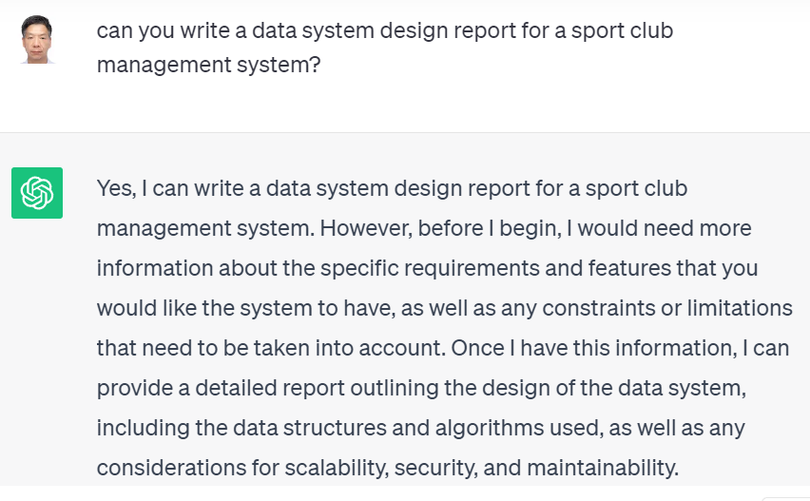
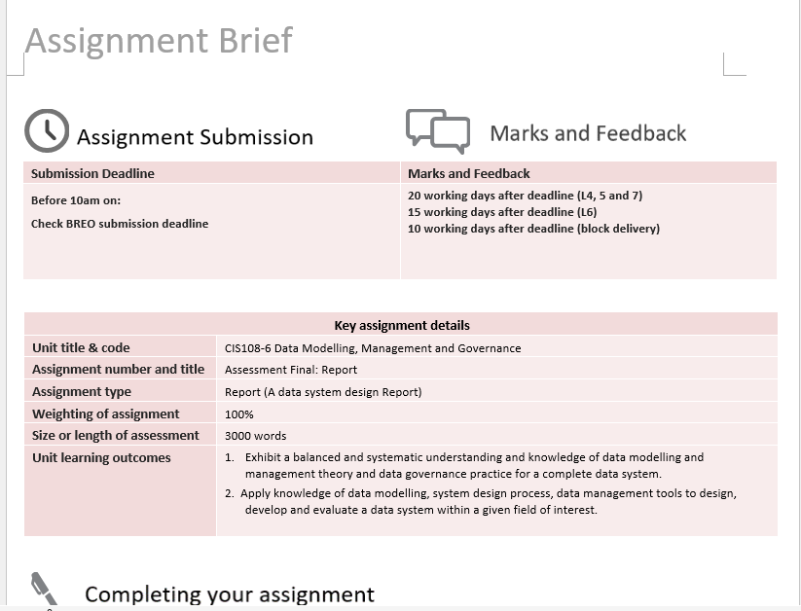
ChatGPT

Slide 24
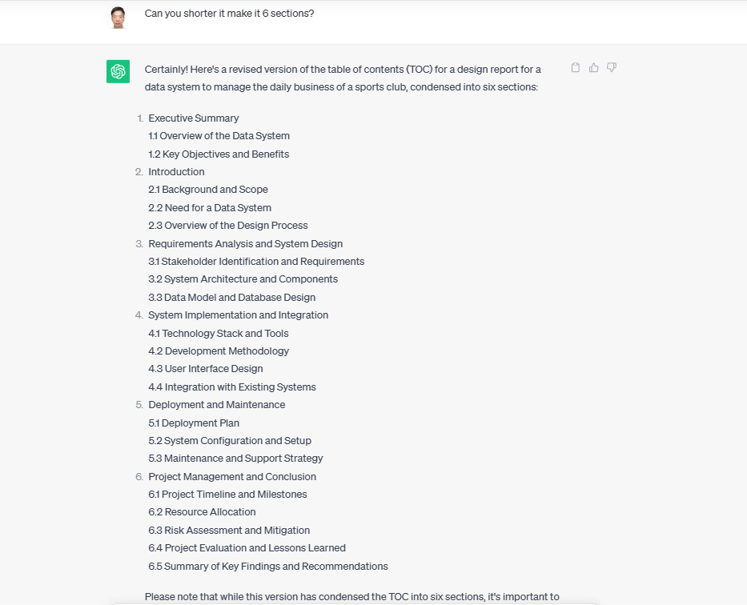
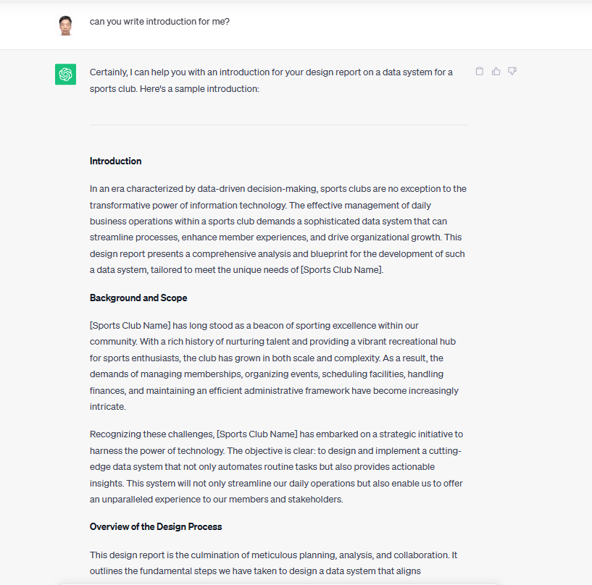
More …

Slide 25
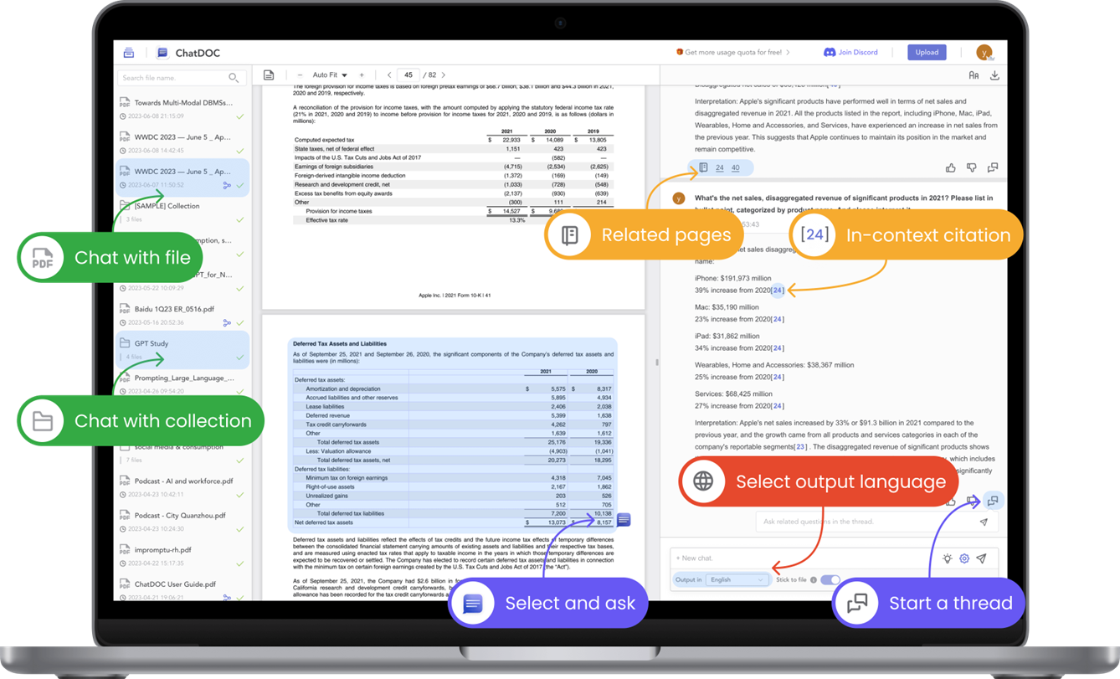
GAI tools for Academics
Chatdoc

Slide 26
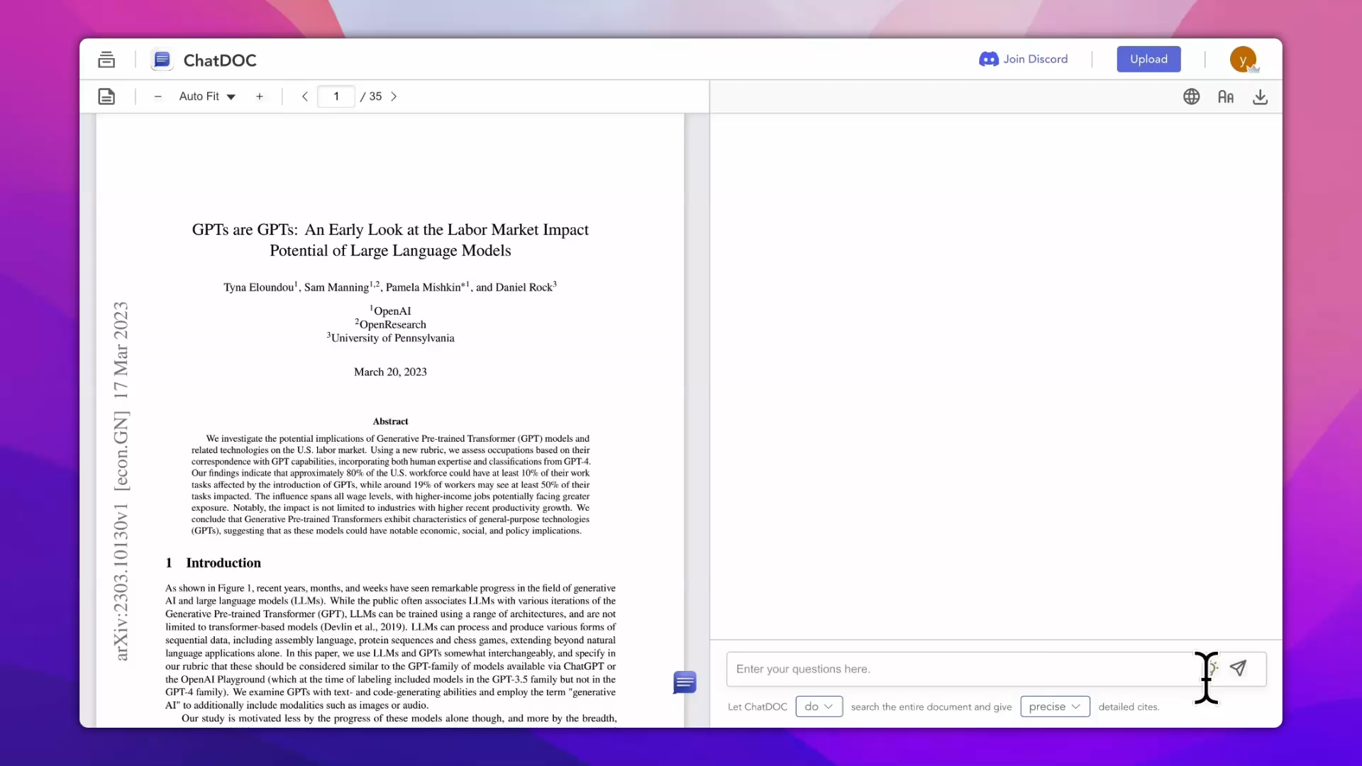
Chatdoc

Slide 27
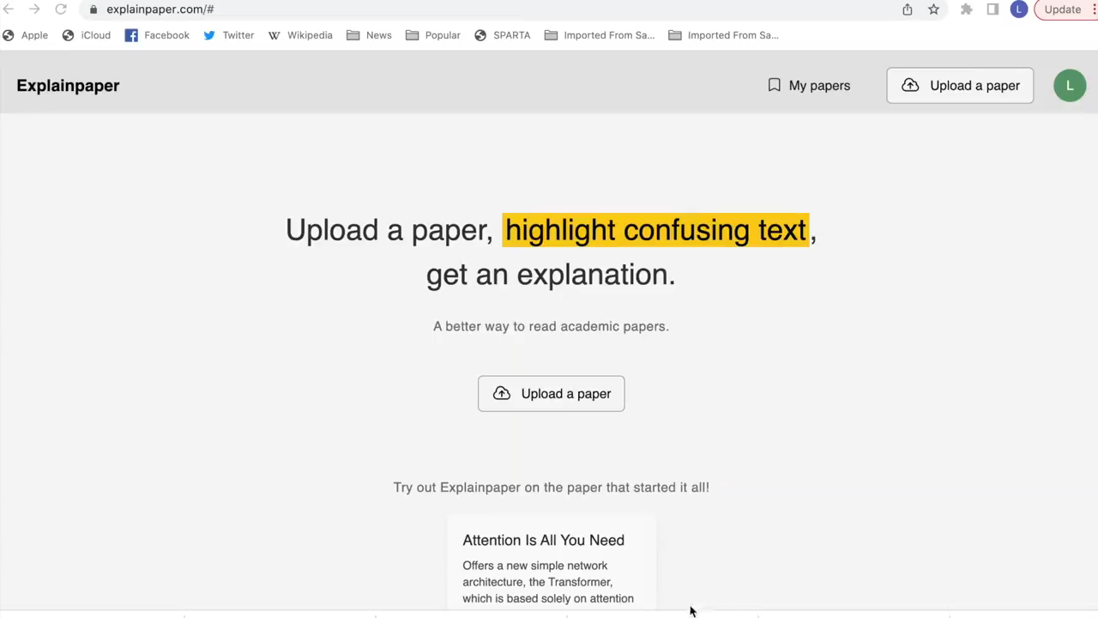
Explainpaper

Slide 28
More GAI tools for researcher
Humata
Elicit
Wordtune read
Quillbot
Spinbot
GPT minus 1
ChatGPT
Paper Digest
Citefast
Mybib

Slide 29
But …
GAI could cause problems
GAI’s misuse from spreading misinformation through creating deepfake content to perpetuating societal biases, instructing harmful and dangerous actions, can cause harm to individuals, business, and society.
https://incidentdatabase.ai/

Slide 30
Some incidents
Class-action lawsuit filed against GitHub, Microsoft, and OpenAI
[https://www.perkinscoie.com/en/news-insights/first-lawsuits-arrive-addressing-generative-ai.html]
Intellectual Property Disputes:
In January 2023, stock image supplier Getty Images took Stability AI to court for reportedly using millions of images from its site without permission to train Stable Diffusion.
Social disturbance
Fake human figures, Fake videos, Fake user feedback
ChatGPT could be tricked into giving detailed instructions on how to build a bomb

Slide 31
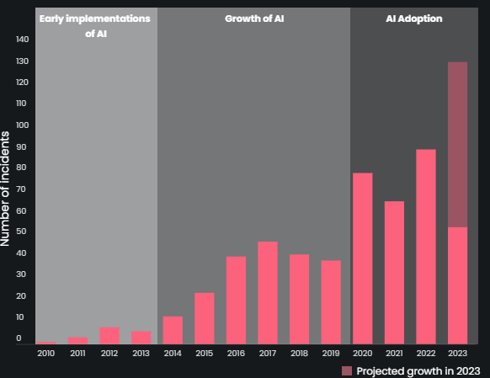
55 AI Incidents have been reported
2023 is predicted to have the largest number of AI incidents
Data source: Aincidentdatabase.ai

Slide 32
Two kinds of problems
Technological problems (Technical Ethics)
Misinformation: Incorrect/untrue (training data)
Bias: gender/racial/religion (training data)
Transparency: Blackbox, Unexplainable (model)

Slide 33
Two kinds of problems
Adoption problems (Societal Ethics)
Misuse
Originality (Copyright and intellectual property)
Deepfake (Intentionally)
Instructing harmful and dangerous actions (Deliberatively)

Slide 34
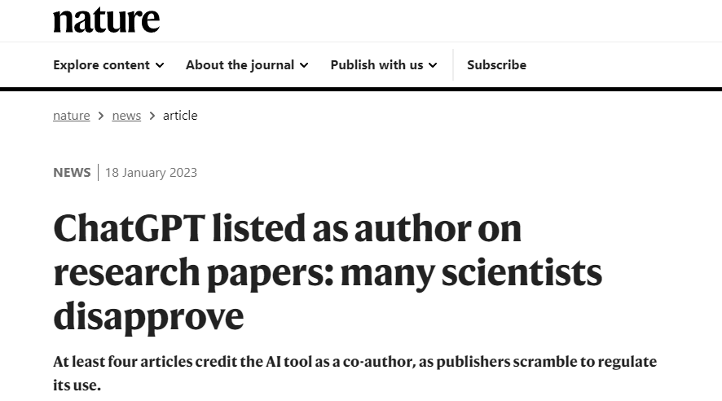
GAI’s problems in HE context
Threat to integrity:
Cheating
Fraud
Copy

Slide 35
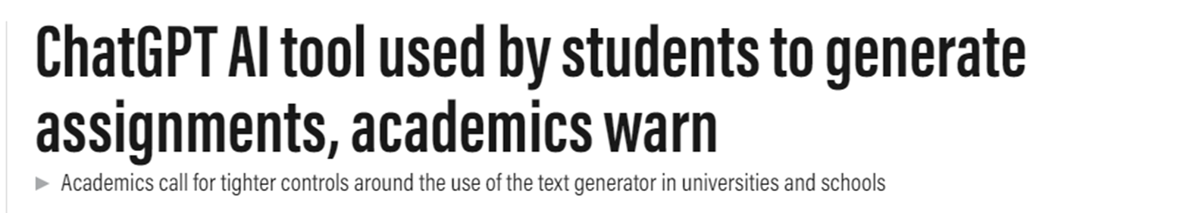
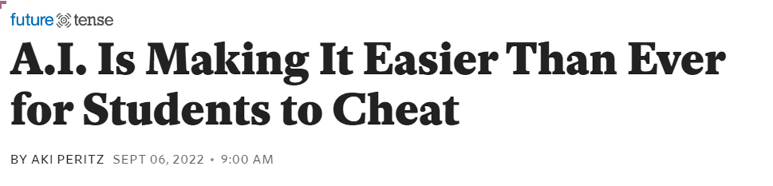
GAI’s problems in HE context
Opens the door to cheating and plagiarism
incidentdatabase.ai

Slide 36
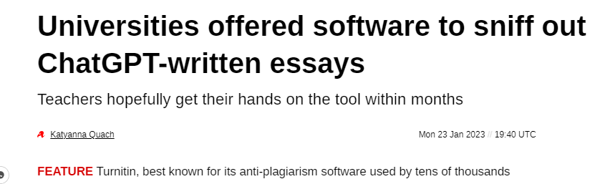
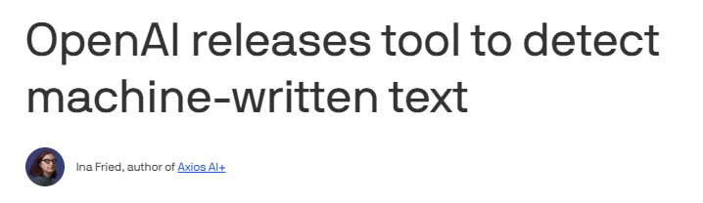
What do we do?

Slide 37
Example of AI detections
GPTZero
Turnitin
OpenAI classifier

Slide 38
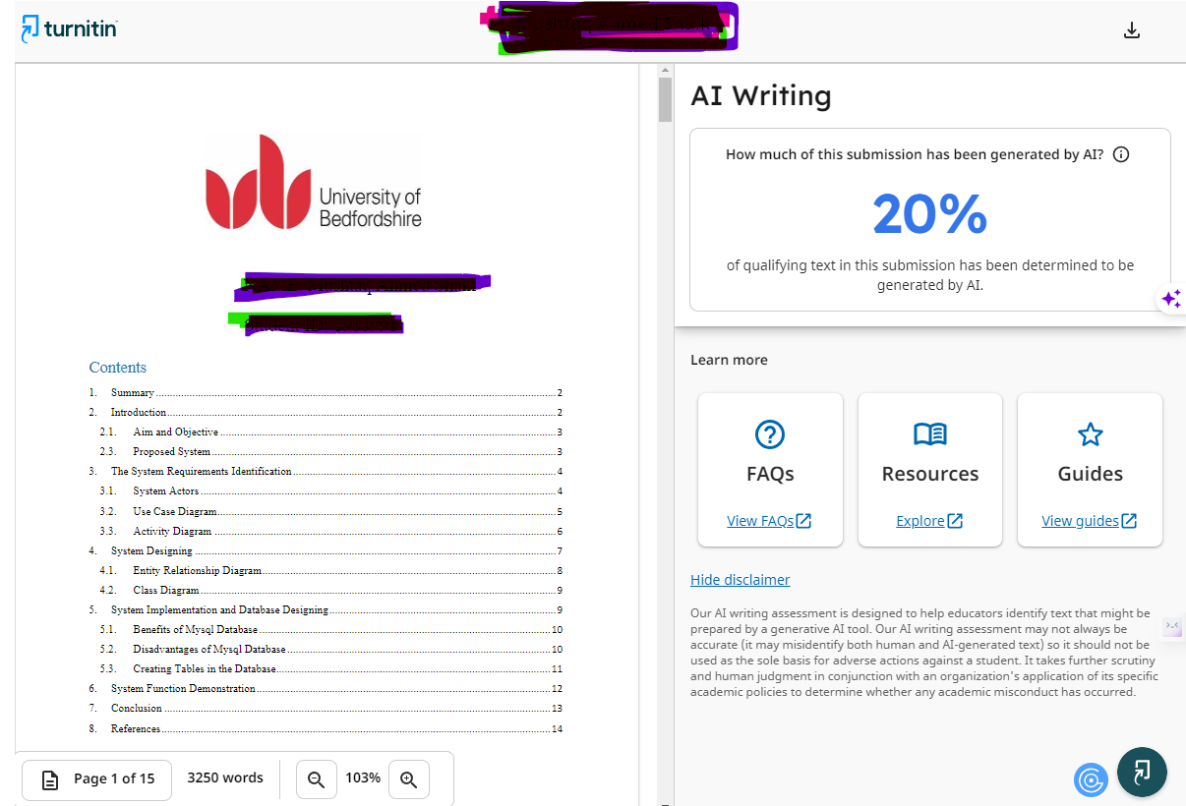
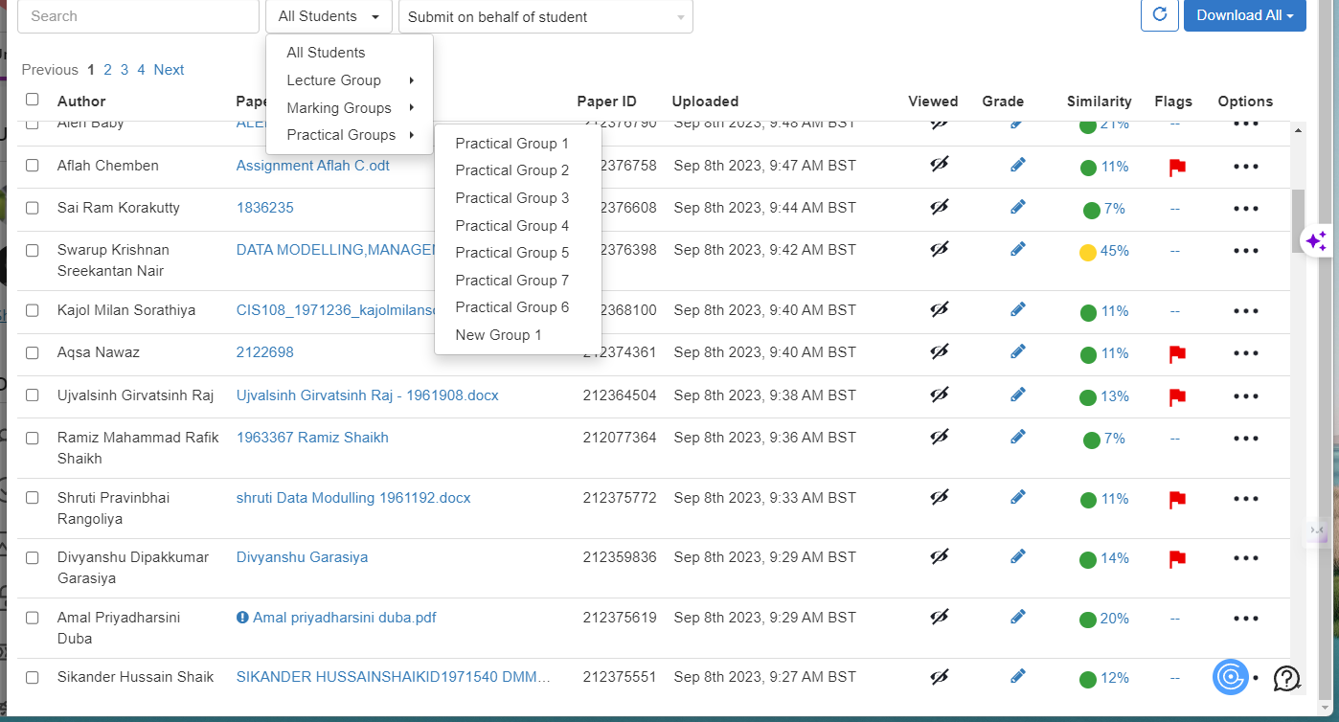
BREO

Slide 39
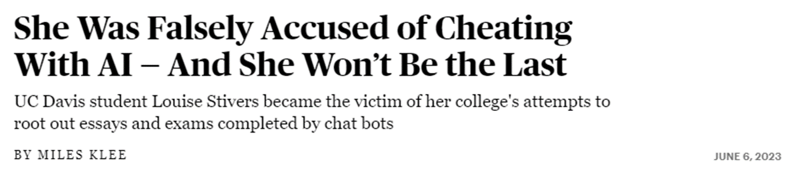
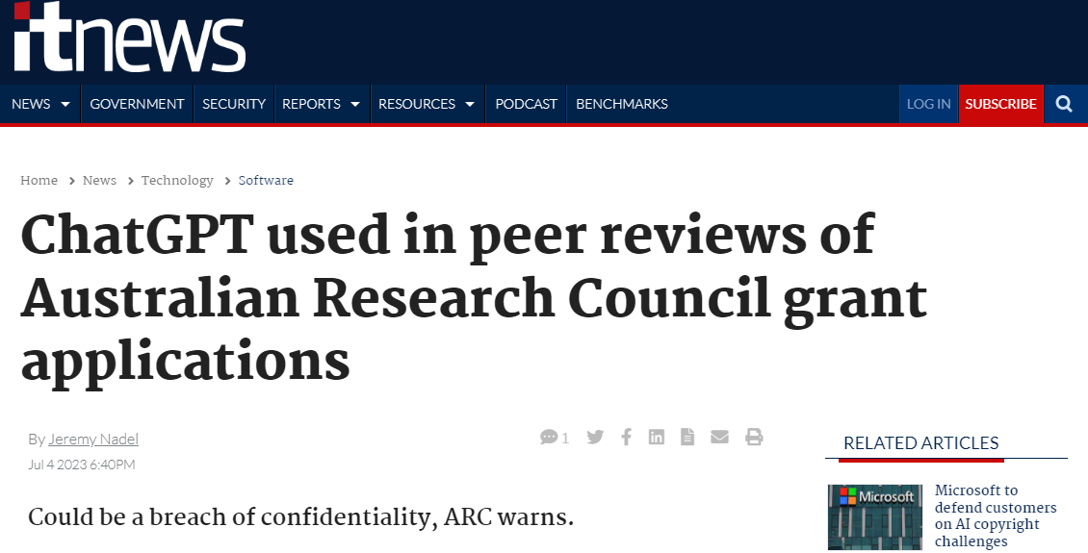
What are the results?

Slide 40
3. Is GAI opportunity or threat for HE?

Slide 41

Split Views in HE context
“While some view it as a tool to enhance learning and reduce teacher workload, others see it as a threat to integrity which opens the door to cheating and plagiarism.”

Slide 42
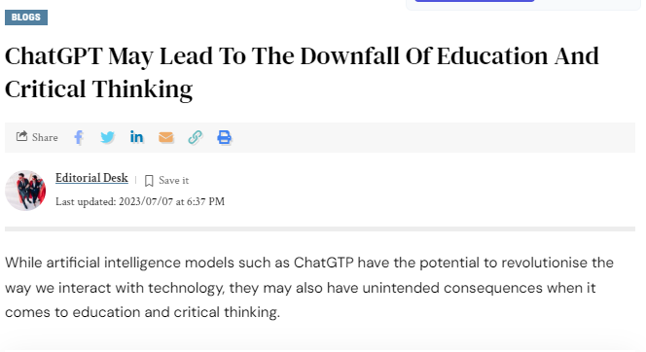
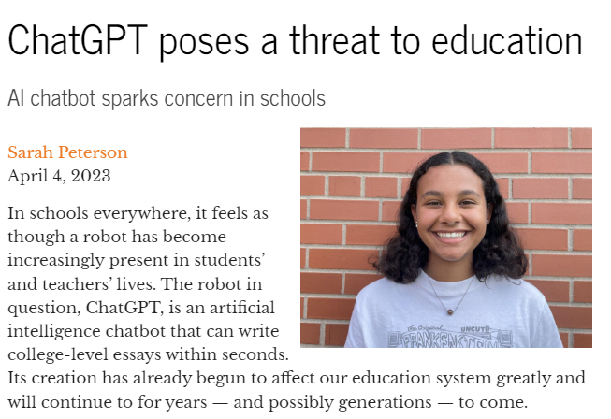
Threat’s view

Slide 43
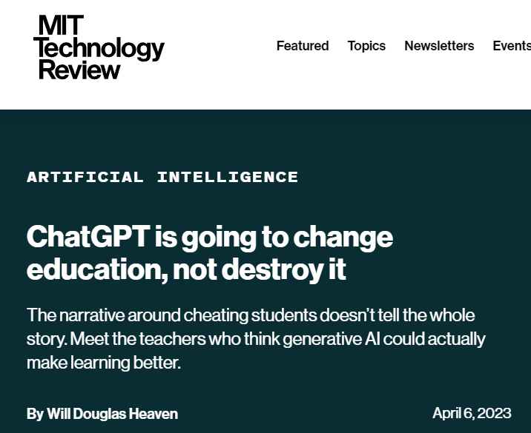
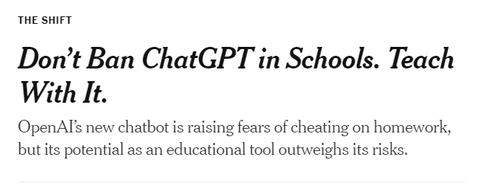
Pros’ view

Slide 44
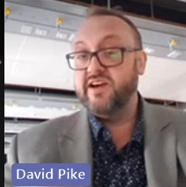
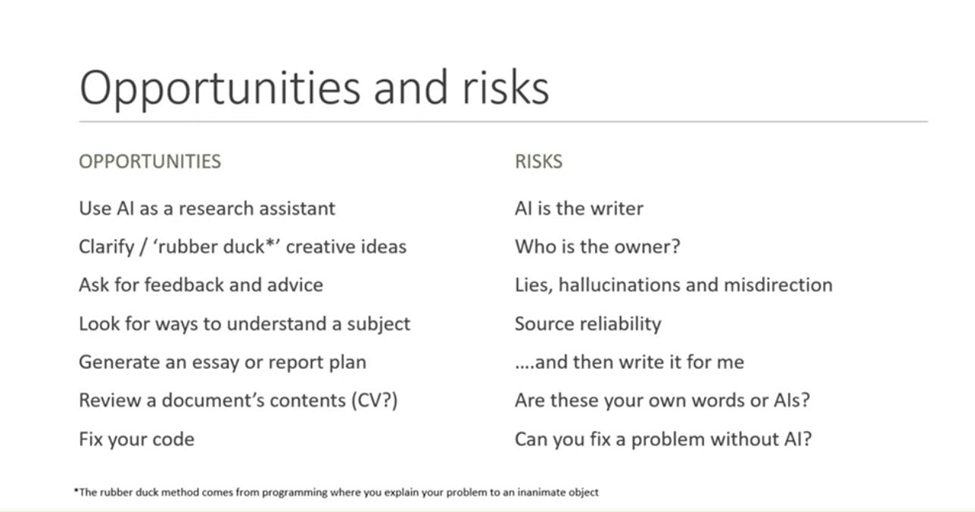

Slide 45
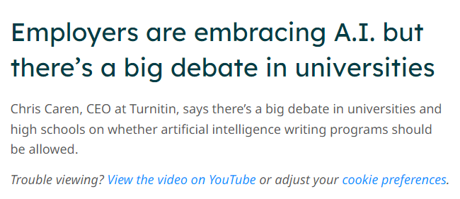
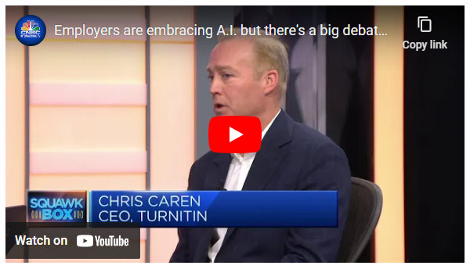
Turnitin

Slide 46
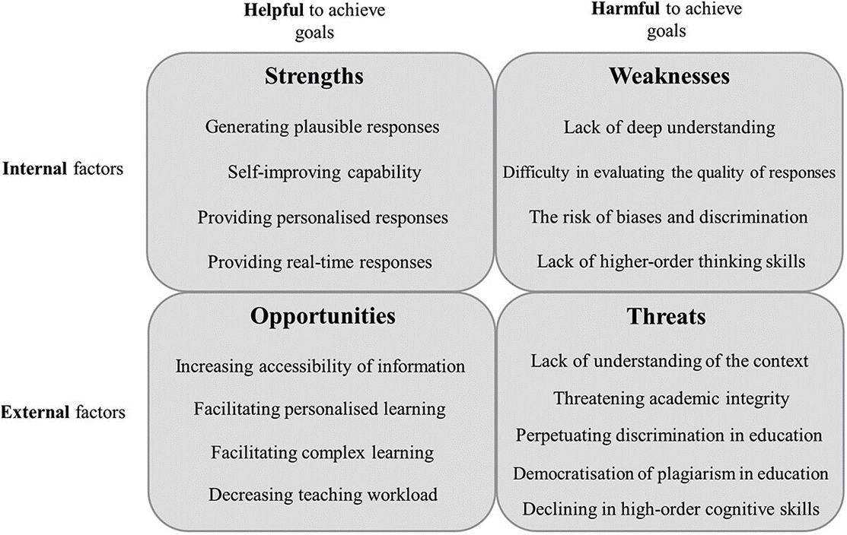
A quick SWOT
Mohammadreza Farrokhnia, Seyyed Kazem Banihashem, Omid Noroozi & Arjen Wals (2023) A SWOT analysis of ChatGPT: Implications for educational practice and research, Innovations in Education and Teaching International, DOI: 10.1080/14703297.2023.2195846

Slide 47

Opportunities for Learners
Personal Tutor
Help to understand and solve complex problems (math and logical problems)
Ask a question they may not ask their tutors
Help develop problem-solving skills and analytical and out-of-the-box thinking.
Develop writing skills by providing suggestions (e.g., syntactic and grammatical)
Developing language skills, programming
Create practice exercises and quizzes for various subjects (prepare for exam)
Create explanations and step-by-step solutions to a given problem

Slide 48

Opportunities for Learners
Useful Tools
Can be used for group discussions and debates by providing personalized guidance
An excellent platform to experiment and hands-on learning (programming and coding)
Project management, report writing, and technical report writing.

Slide 49

Opportunities for Learners
Assistant
Interactive help anytime and anywhere.
Support learners with disabilities by providing services such as speech-to-text and text-to-speech.
Doing thing I don’t want to, I cannot.

Slide 50

Opportunities for educators
Contents creator
Creation of educational content (textbooks, lecture notes, and other learning resources)
Allows educators to focus more on facilitating discussions, providing guidance, and addressing students' specific needs.

Slide 51

Opportunities for educators
Useful Tools
Can analyse large amounts of data and derive insights and student learning patterns
Can help institutions identify areas for improvement and enhance the overall learning experience.
Hypothesis generation, data analysis and simulation modelling.
New discoveries and innovative solutions to complex problems.

Slide 52
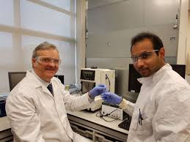
Opportunities for educators
Teaching/Research Assistant
AI-powered virtual teaching assistants can provide immediate support to students, answering questions, providing feedback, and offering guidance.
These assistants can be available 24/7, ensuring that students receive timely assistance even outside of regular class hours.

Slide 53
Threats and challenges:
Academic Integrity: AI systems can be used to generate essays, papers, and other academic works, potentially facilitating plagiarism and cheating.
2. Lack of understanding of the context
3. Bias and Ethics: Generative AI models are trained on existing data, which can include biases and discriminatory patterns. If not properly addressed, this could perpetuate inequalities in education.
4. Overreliance on Technology: While AI can enhance the learning experience, there is a risk of overreliance on technology. It is important to strike a balance between leveraging AI tools and maintaining human interaction, critical thinking, and creativity in education.
5. Privacy and Data Security: protect sensitive student information and ensure compliance with relevant regulations

Slide 54
4. What will we do?

Slide 55
What will we do?
We can Ban it completely.
Fully focus on GAI’s weaknesses and its potential threats to education, fear of a negative impact on education and learning
The history tells us when facing “disruptive technology”, you either in brace it or being disrupted

Slide 56
What should we do?
Focus only on ChatGPT’s threats to education and attempt to look for ways to mitigate the threats:
Develop more intelligent software for detection
Deploy signature for AI generated contents
Change exam or tests prompts
Outsmart students

Slide 57
What should we do?
Rely on university policy and software to detect and deal with it.
Continue to ignore ChatGPT’s strength and its opportunities for Students and just treat using AI in exam or homework as cheat or plagiarism.
Any policy is always falling behind the technology
Speed of AI detection software cannot compete with the rapid developments of emerging AI technologies.

Slide 58
What should we do?
Pretend nothing is wrong with use of AI and ignore the existence of ChatGPT and other AI models. Business as usual
This could create imbalanced, unfairness among students
Cause chaos in educational settings and frustration both for teachers and students

Slide 59
Conclusion
Whether GAI is viewed as an opportunity or a threat for Higher Education depends on how it is harnessed and managed.
We are only at the beginning of understanding the impact of GAI for education. More research needs to be done.
Like many other disruptive technologies, use of GAI should be considered:
To maximize the benefits and mitigate potential risks
To enhance, rather than replace, the human element of teaching and learning.

Slide 60
This needs ….
Rethinking of education
Purposes (get a certificate and move on vs thinker of problem solver)
Methods:
Adjust curricula,
Redefine learning outcomes (creativity and critical thinking skills),
Re-arrange learning tasks,
Adopt new assessment approaches (not only check final the result but the process of produce the results.
A lot of efforts and hard work.

Slide 61
Thanks for attention

Slide 62
To maximize the benefits and mitigate potential risks, it is crucial for educational institutions and policymakers to carefully consider the ethical, economic, and social implications of integrating GAI into higher education and to ensure that it is used to enhance, rather than replace, the human element of teaching and learning. Additionally, ongoing research, transparency, and collaboration are essential to navigate the evolving landscape of GAI in education effectively.

Slide 63
Rethinking Assignments
Be clear with your students about whether and how AI tools can be used
You are not allowed to use ChatGPT (or tools like it) for your work for this class. Using such tools will be considered a violation of Penn’s Code of Academic Integrity and suspected use will be reported to the Center for Community Standards & Accountability. Please contact me if you have any questions about this policy.
You may use ChatGPT and other AI assistants for your work in this class but you must contact me for permission first so we can discuss how you plan to use these tools and how you will indicate their use in your work. If you do not first request permission, using such tools will be considered a violation of Penn’s Code of Academic Integrity.

Slide 64
Rethinking Assignments
2. Explain why you have given them a specific assignment and explain the value of the thinking they will do
Being transparent with students about the purpose of an assignment, can help students appreciate what they are learning, the importance of the skills they are developing, and the excitement of creating their own ideas.

Slide 65
Rethinking Assignments
3. Consider testing your assignments using ChatGPT.
Seeing what the tool produces can help you think about what you’re assigning to students – and what an AI-generated response might look like. Consider sharing what you’ve found with students. Pointing out any issues you’ve seen regarding the quality and accuracy may help students better understand these tools and their limitations (both for their classwork and beyond).

Slide 66
Rethinking Assignments
4. Keep in mind current limitations of detection software
There are lots of efforts to develop effective means of detecting AI-written prose, but at present it is not clear how effective any will be. Nevertheless, you can try running student work through the plagiarism-detection tool in Canvas, Turnitin. According to Turnitin’s blog, Turnitin can currently “detect some forms of AI-assisted writing” and they plan to roll out additional features to improve detection in the coming year.

Slide 67
Rethinking Assignments
5. Tweak or rethink assignments taking ChatGPT’s current limitations into account.
Cite their sources, even in informal work. If prompted for sources, ChatGPT has been known to make-up sources that do not exist.
Incorporate or engage with ideas from particular sources or discussions from class. In particular, articles, media, and other content that requires a login or subscription will likely not be accessible to ChatGPT.
Respond to visual materials. ChatGPT cannot yet interpret images.

Slide 68
Rethinking Assignments
6. Consider designing assignments that make students’ thinking
Submit notes they took on sources to prepare their papers
Write briefly about a source they decided not to use and why they did not.
Do presentation explain the rationality of their approaches or solutions

Slide 69
Rethinking Assignments
7. Make their process of doing the work more visible.
Submit components of assignments in steps prior to the final deadline, so the development of their ideas or work over time can be seen.
Submitting an outline, a list of sources, an explanation of their approach, or a first draft before the final product.
Asking the differences between your report and the report suggested by ChatGPT.

Slide 70
Thanks for attention

